Slide 1
Chapter 7- Introduction to Flutter

Slide 2
Flutter
In general, developing a mobile application is a complex and challenging task.
There are many frameworks available to develop a mobile application.
Android provides a native framework based on Java language and iOS provides a native framework based on Objective-C / Swift language.

Slide 3
Flutter
However, to develop an application supporting both the OSs, we need to code in two different languages using two different frameworks.
To help overcome this complexity, there exists mobile frameworks supporting both OS.
These frameworks range from simple HTML based hybrid mobile application framework (which uses HTML for User Interface and JavaScript for application logic) to complex language specific framework (which do the heavy lifting of converting code to native code).
Irrespective of their simplicity or complexity, these frameworks always have many disadvantages, one of the main drawback being their slow performance.

Slide 4
Flutter
In this scenario, Flutter – a simple and high performance framework based on Dart language, provides high performance by rendering the UI directly in the operating system’s canvas rather than through native framework.
Flutter also offers many ready to use widgets (UI) to create a modern application. These widgets are optimized for mobile environment and designing the application using widgets is as simple as designing HTML.

Slide 5
Flutter
To be specific, Flutter application is itself a widget. Flutter widgets also supports animations and gestures.
The application logic is based on reactive programming. Widget may optionally have a state.
By changing the state of the widget, Flutter will automatically (reactive programming) compare the widget’s state (old and new) and render the widget with only the necessary changes instead of re-rendering the whole widget.

Slide 6
What is Flutter
Flutter is a platform provided by google to create native mobile application It support both Android and iOS platforms.
It can be use without even using android studio or Xcode.
It make use of dart programming which is quite similar to c++,java.
It make fast Development and has built in native widgets for building

Slide 7
What is Flutter
Flutter is an open-source software development kit which enables smooth and easy cross-platform mobile app development.
You can build high quality natively compiled apps for iOS and Android quickly, without having to write the code for the two apps separately.
All you need is one codebase for both platforms.

Slide 8
Features of Flutter
Flutter framework offers the following features to developers −
Modern and reactive framework.
Uses Dart programming language and it is very easy to learn.
Fast development.
Beautiful and fluid user interfaces.
Huge widget catalog.
Runs same UI for multiple platforms.
High performance application.

Slide 9
Advantages of Flutter
Flutter comes with beautiful and customizable widgets for high performance and outstanding mobile application. It fulfills all the custom needs and requirements. Besides these, Flutter offers many more advantages as mentioned below −
Dart has a large repository of software packages which lets you to extend the capabilities of your application.
Developers need to write just a single code base for both applications (both Android and iOS platforms). Flutter may to be extended to other platform as well in the future.
Flutter needs lesser testing. Because of its single code base, it is sufficient if we write automated tests once for both the platforms.
Flutter’s simplicity makes it a good candidate for fast development. Its customization capability and extendibility makes it even more powerful.
With Flutter, developers has full control over the widgets and its layout.
Flutter offers great developer tools, with amazing hot reload.

Slide 10
Disadvantages of Flutter
Despite its many advantages, flutter has the following drawbacks in it −
Since it is coded in Dart language, a developer needs to learn new language (though it is easy to learn).
Modern framework tries to separate logic and UI as much as possible but, in Flutter, user interface and logic is mixed. We can overcome this using smart coding and using high level module to separate user interface and logic.
Flutter is yet another framework to create mobile application. Developers are having a hard time in choosing the right development tools in hugely populated segment.

Slide 11
Dart: the language used by Flutter
Dart is an object-oriented programming language that was first unveiled by Google in 2011.
Since then Dart steadily evolved by releasing different features. Among others, it is worth mentioning the “dart2native” feature that allows compiling it for Windows, Linux, and macOS platforms as a desktop application.
As of the writing this article, the desktop solution is not production-ready but the outlook seems promising.
Aside from this, the Dart program can be composed into a self-contained executable file or compiled to JavaScript.
The last one is especially notable because with compiling to JavaScript you can run Dart programs in every modern web-browser.
Web solution is not production ready and currently in beta release.

Slide 12
Dart: the language used by Flutter
In general, the Dart language is easy to study. Its syntax is pretty similar to Java, Swift, or Kotlin languages.
Moreover, the Dart software development kit (SDK) is shipped with a stand-alone Dart Virtual Machine (VM) that allows you to build the code in a command-line interface (CLI) environment and if you are not familiar with CLI then you can play around with the Dart in DartPad.
DartPad is an online editor that provides access to Dart’s API and allows you to compile the Dart code.

Slide 13
Flutter Framework
As was previously mentioned, the Flutter framework was first unveiled by Google in 2015.
Its code name was “Sky” and it ran on the Android operating system.
The first stable release was delivered on the 4 of December 2018 and on May 6, 2020, the Dart SDK version 2.18 and Flutter version 1.17 were released delivering a build with Metal API integration.
This has provided performance improvements to the iOS platform.
The framework is written using C, C++, and Dart languages and uses Google’s Skia Graphics Engine for user interface rendering.
This graphics engine is used for such known products as Google Chrome, Chrome OS, Chromium OS, Mozilla Firefox, Mozilla Thunderbird, Android, Firefox OS, and now the Flutter.

Slide 14
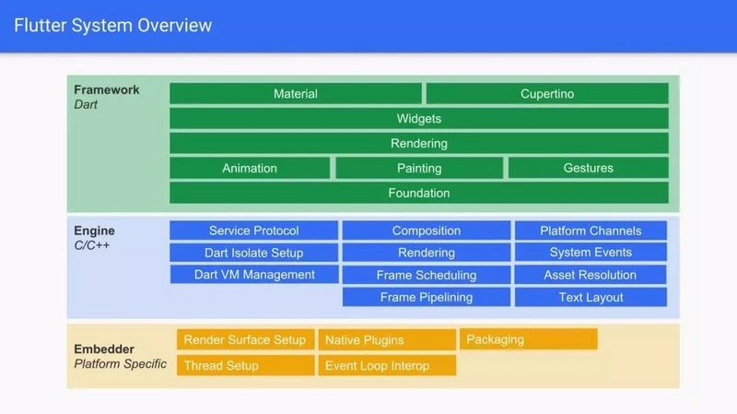
Flutter System Overview

Slide 15
Flutter Architecture
Flutter delivers the basic architecture that you can apply to your application and manage its state easily.
The architecture that is used in Flutter is called the Business Logic Component (BLOC).
Basically, it is an event-state based approach that allows you to trigger events and handle state changes based on them.
The BLOC is a good approach that separates your business logic from the user interface and oversees business logic key points by testing.
The core ideas that were used for BLOC architecture are simplicity, scalability, and testability, and all these goals were definitely achieved within the BLOC architecture.

Slide 16
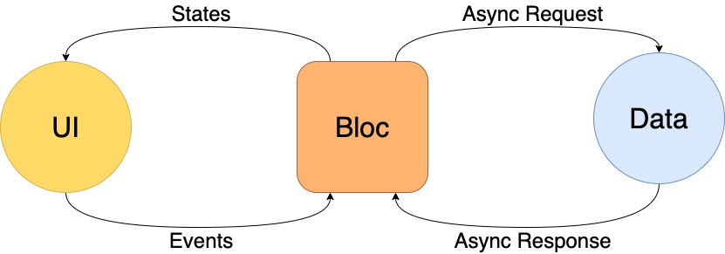
Flutter Architecture

